Slide 1
Mass Communication Before Writing

Slide 2
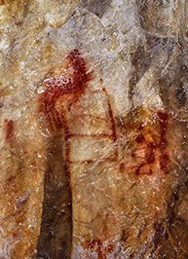
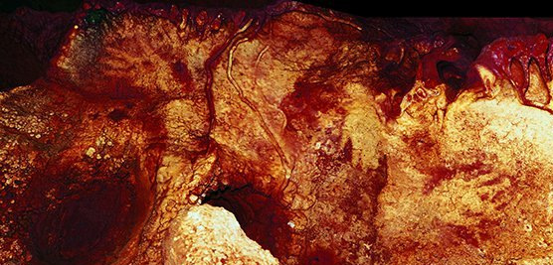
Art as Mass Comm.
Cave Paintings
Neanderthal Paintings
La Pasiega, Spain, ca. 62,000 B.C.E.
Maltravieso, Spain, ca. 64,000 B.C.E. (color enhanced)
Boissoneault, 2021

Slide 3
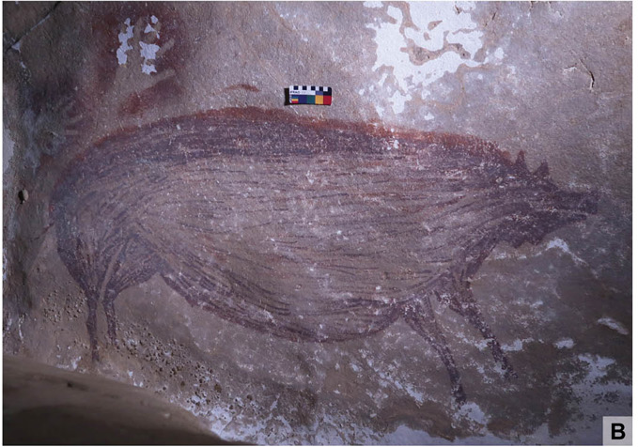
Art as Mass Comm.
Cave Paintings
Maros-Pangkep, Indonesia
circa 43,500 B.C.E.
Brumm, 2021

Slide 4
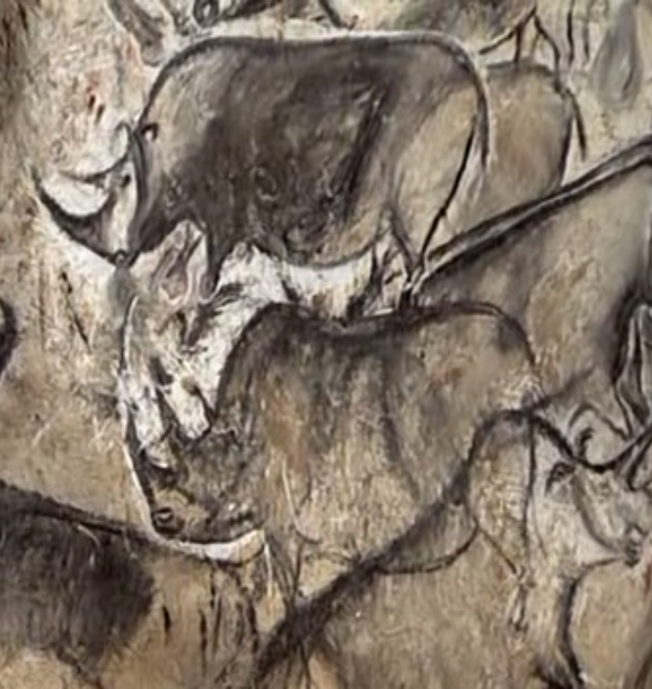
Art as Mass Comm.
Cave Paintings
Chauvet Cave, ca. 30,000 B.C.E.

Slide 5
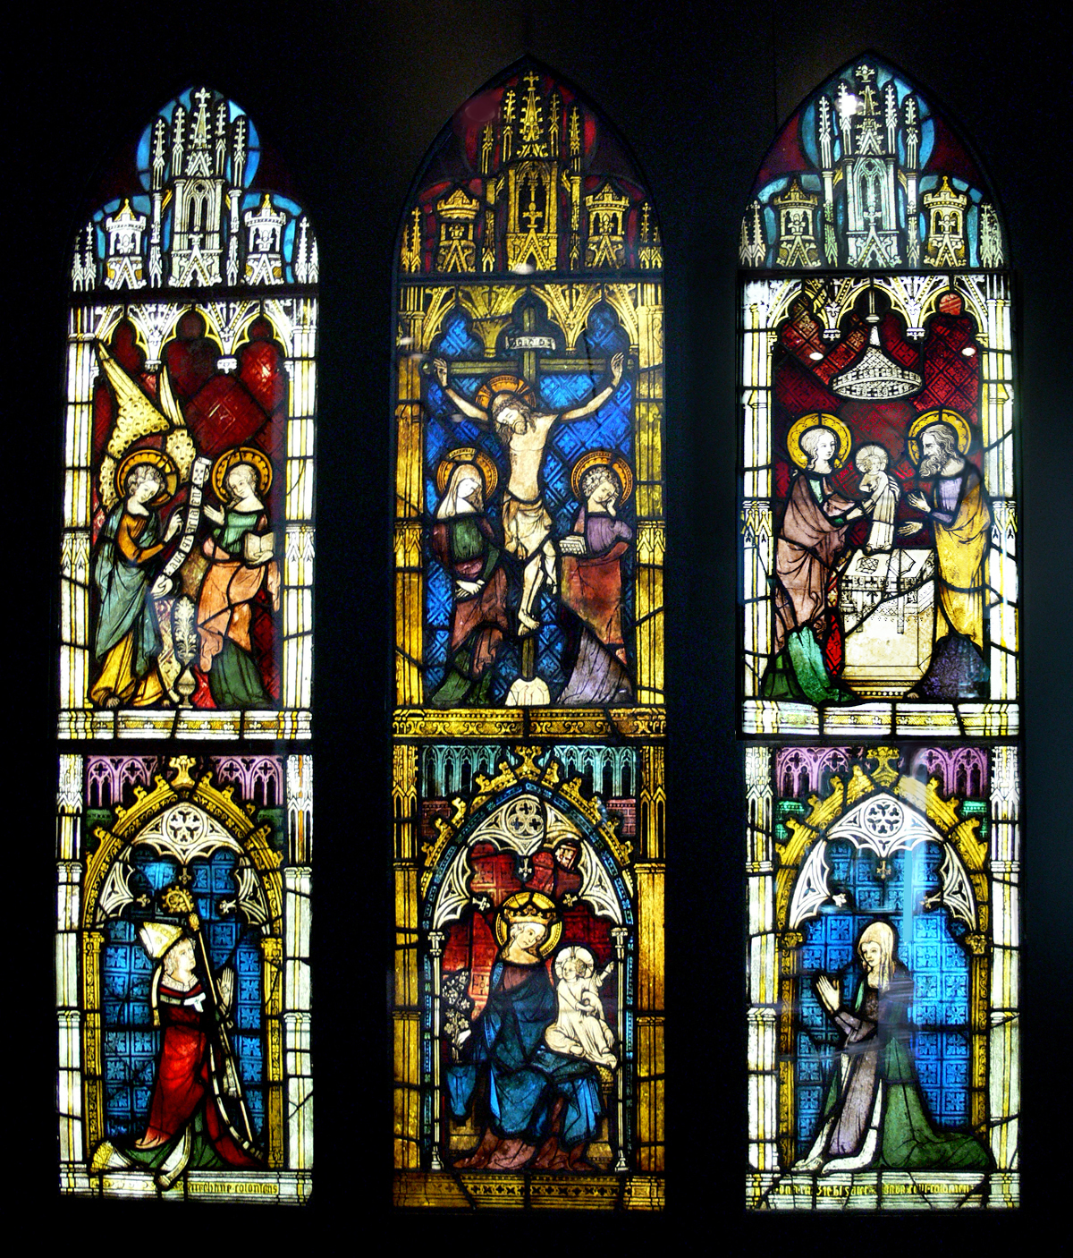
Art as Mass Comm.
We still do this!
Cologne Cathedral, Germany.
1340
User:FA2010, 2009

Slide 6
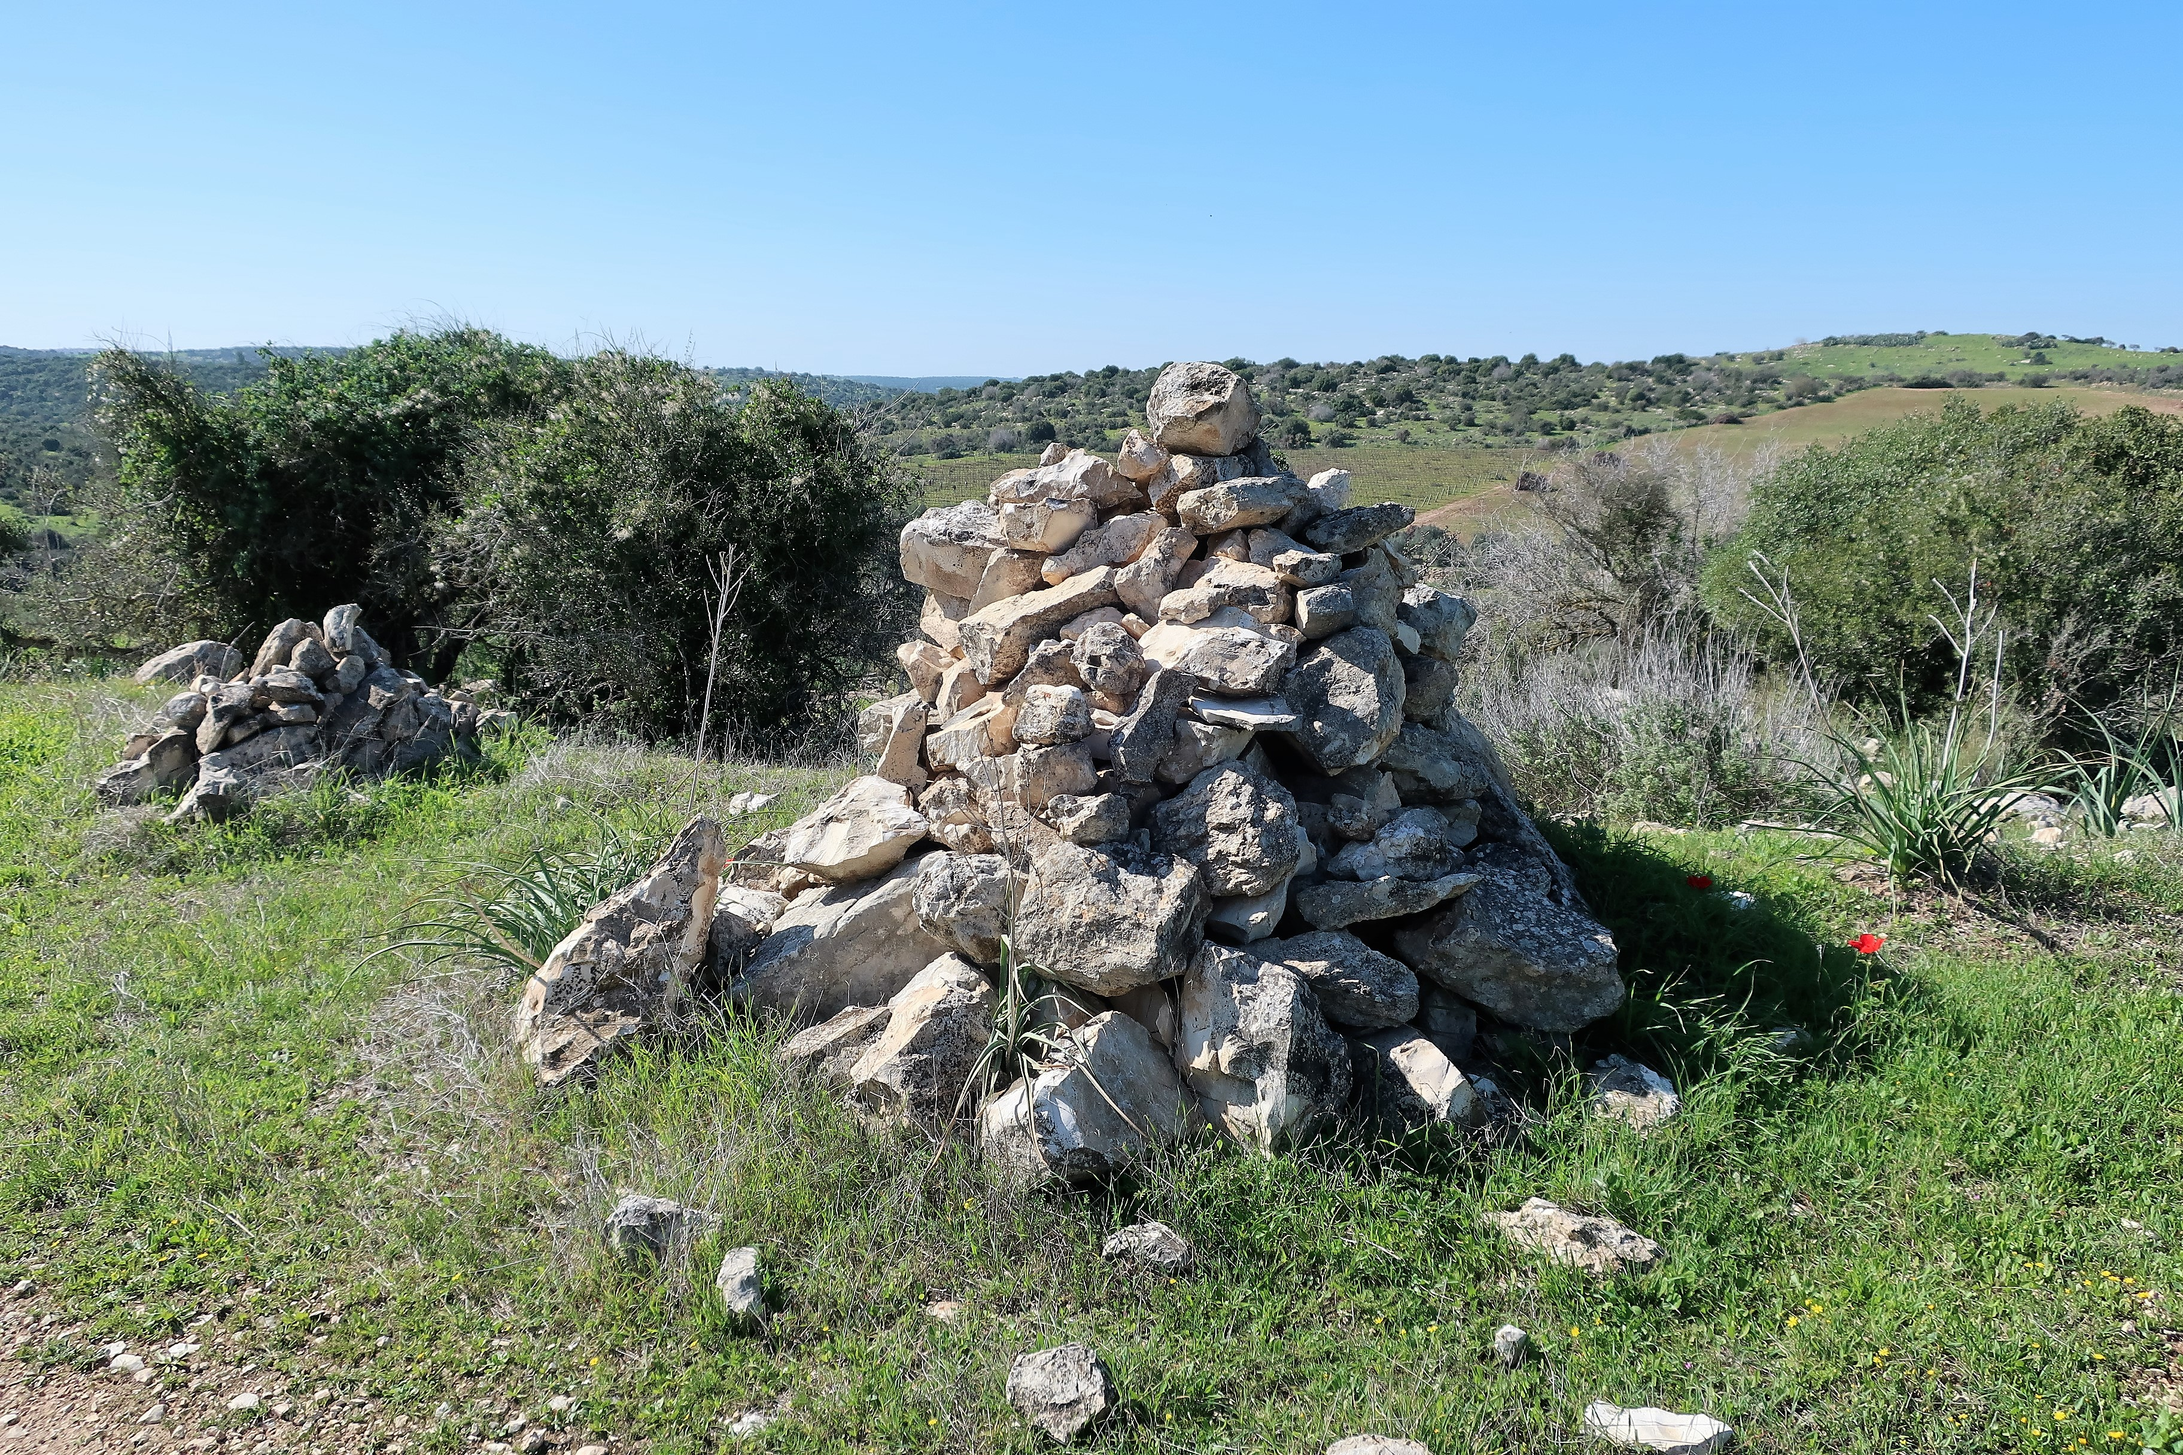
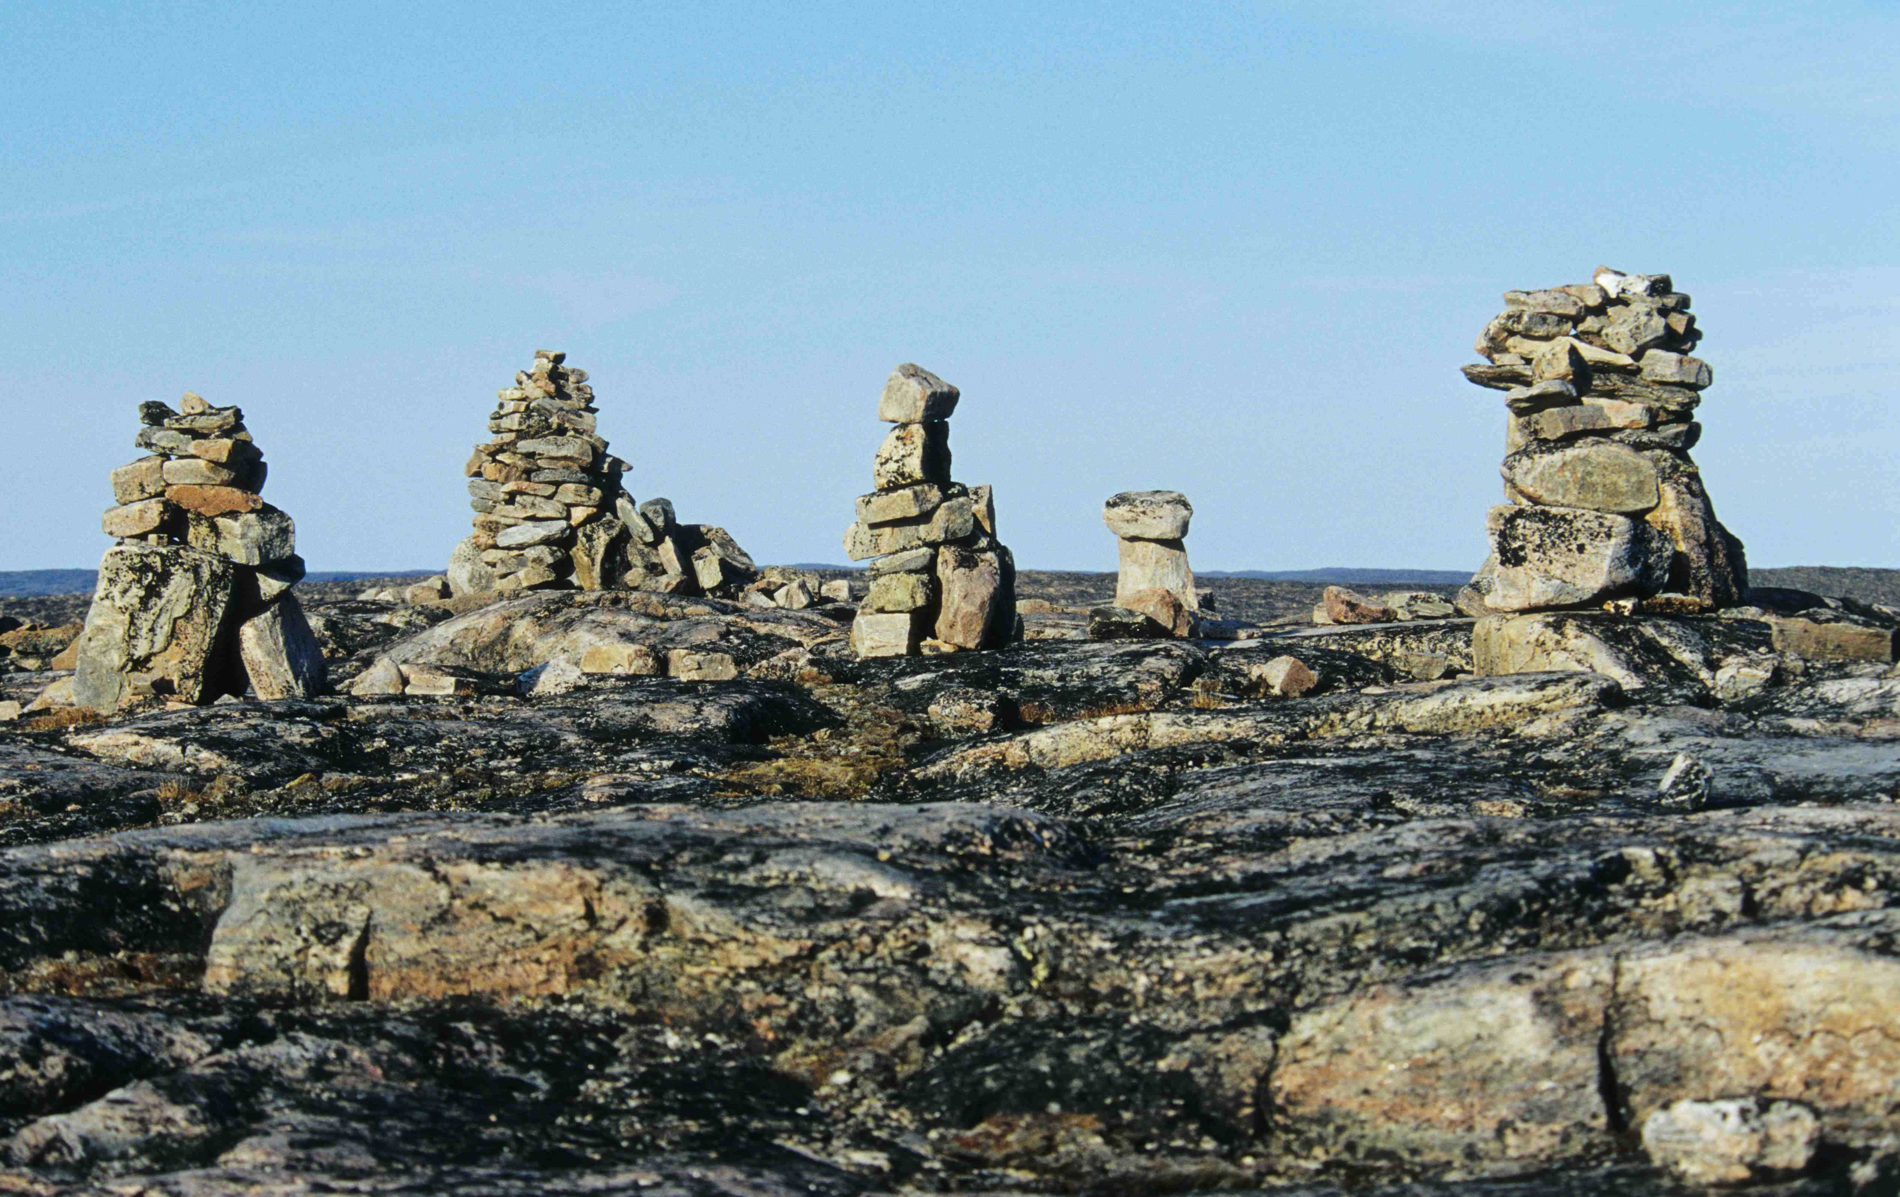
Trail Markings as Mass Comm.
Rock Markers
Cairns are larger rock piles
In many languages, the word for “Cairn” in anthropomorphic:
Steinmann (German, “stone man”)
Steenman (Dutch, “stone man”)
Inuksuk (Inuit, “imitation of a person”)
Ometto (Italian, “small man”)
Davidbena, 2021
Walk, 2002

Slide 7
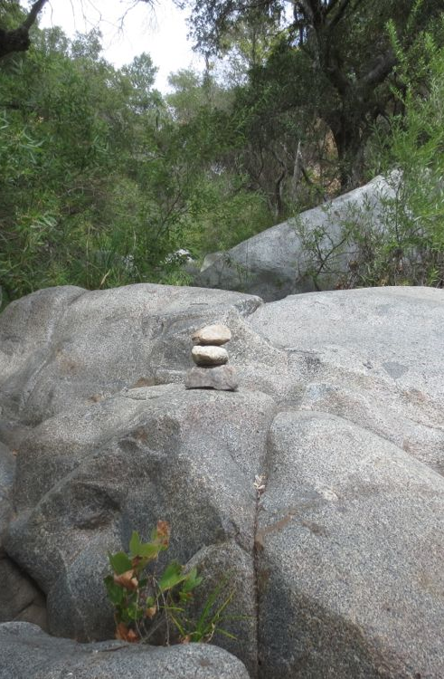
Trail Markings as Mass Comm.
Rock Markers
“Trail Ducks” are smaller rock piles, which serve a similar purpose
They are typically temporary
Hiking Safety, n.d.

Slide 8
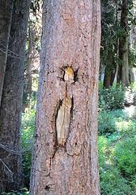
Trail Markings as Mass Comm.
Blazes
Typically carved with an ax or hatchet
Found through North America, Australia, New Zealand. Likely used in other places, but no trees that old remain.
Modern blazes are typically paint or a affixed sign.
HitTheTrail, 2017

Slide 9
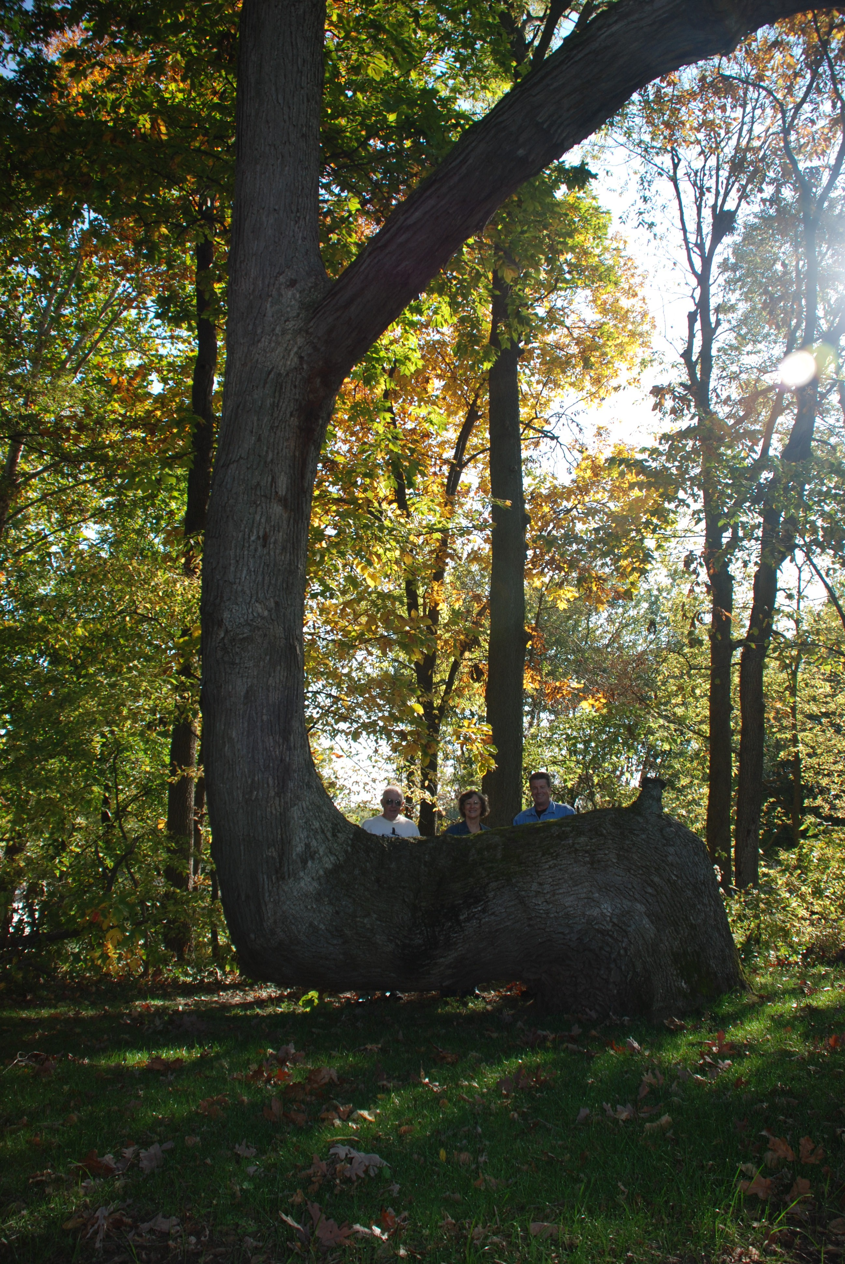
Trail Markings as Mass Comm.
Trail Trees
Marked with distinct bends
Present throughout North American deciduous forests
Likely used in other places, but no trees that old remain.
Downes, 2008

Slide 10
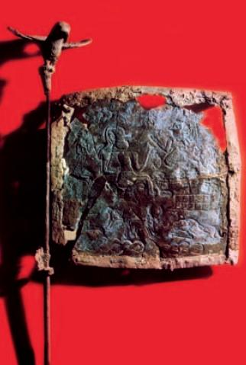
Flags & Standards as Mass Comm.
Unknown author, ca. 2400 B.C.E.

Slide 11
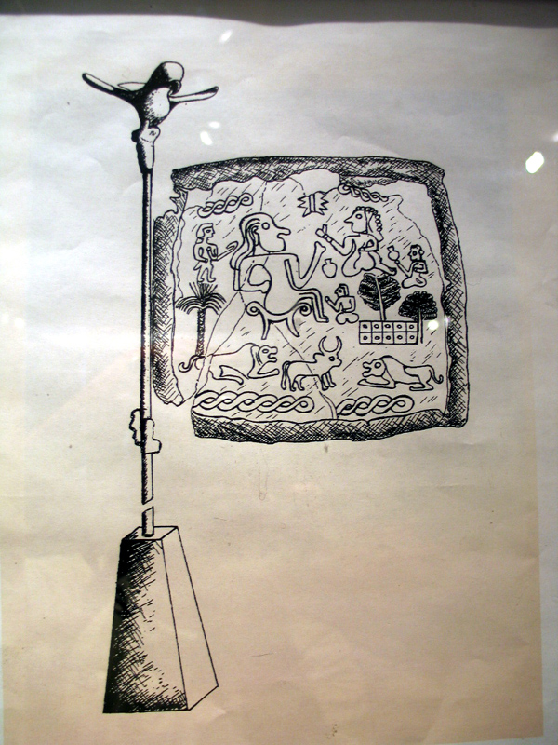
Flags & Standards as Mass Comm.
An easier-to-see transcription of the image
Unknown author, n.d.

Slide 12
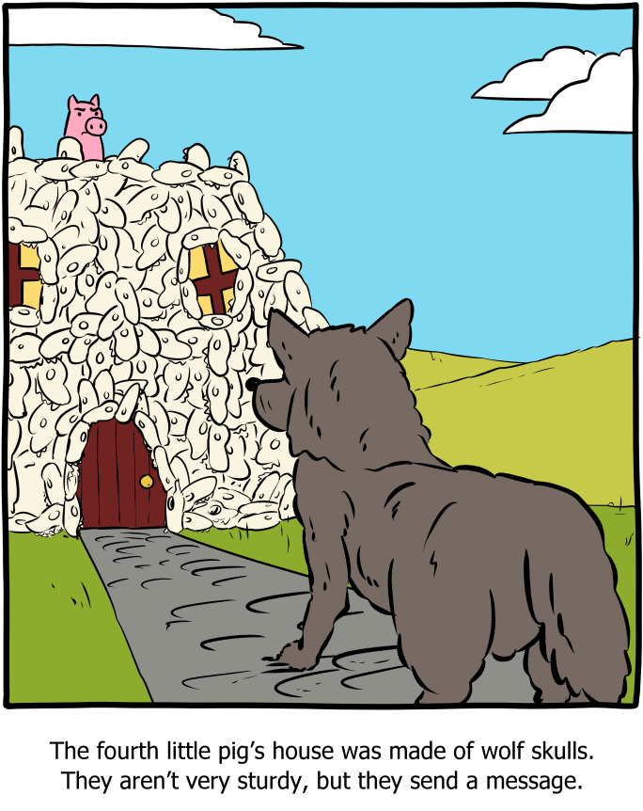
Architecture as Mass Comm.
Weinersmith, 2021

Slide 13
References
Boissoneault, L. (2018, February 22). Were Neanderthals the earliest cave artists? New research in Spain points to the possibility. Smithsonian Magazine. https://www.smithsonianmag.com/science-nature/were-neanderthals-earliest-cave-artists-new-research-spain-points-possibility-180968236/
Brumm, A., et al. (2021). Oldest cave art found in Sulawesi. Science Advances, 7(3). https://doi.org/10.1126/sciadv.abd4648
Davidbena. (2021, January 24). Rock cairn in Judean mountains [Photograph]. Wikimedia Commons. https://commons.wikimedia.org/wiki/File:Rock_Cairn.jpg
Downes, D. (2008). Trail marker tree in White County, IN known as ‘Grandfather’ [Photograph]. Wikipedia. https://en.wikipedia.org/wiki/File:Trail_Marker_Tree_in_White_County,_IN_known_as_'Grandfather'.jpg#/media/File:Trail_Marker_Tree_in_White_County,_IN_known_as_'Grandfather'.jpg
User:FA2010. (2009). Dreiteiliges Kapellenfenster; Köln um 1340, English: Medieval glass from Cologne Cathedral showing Crucifixion and Virgin in Majesty, framed by Annunciation, Presentation at the temple and two donors [Digital image]. Wikimedia Commons. https://commons.wikimedia.org/wiki/File:Kapellenfenster_K%C3%B6ln_um_1340_KGM_paste.JPG
Hiking Safety is your Responsibility. (n.d.) The Hiker’s Way. https://www.thehikersway.com/hikers-u/hiking-safety/
HitTheTrail. (2017, August 19). Old trail blaze conventions [Online forum post]. NWHikers. http://www.nwhikers.net/forums/viewtopic.php?t=8025224
Rhino drawings from the Chauvet Cave. (ca. 30,000 B.C.E.) Wikimedia Commons. https://commons.wikimedia.org/wiki/File:Rhinos_Chauvet_Cave.jpg
Unknown author. (ca. 2400 B.C.E.) Ancient bronze flag found at Shahdad, c. 2400 BC. This flag is one of the oldest in human history [Digital Image]. https://en.wikipedia.org/wiki/Shahdad#/media/File:Bronze_flag,_Shadad_Kerman,_Iran.JPG
Unknown author. (n.d.) Shahdad12. [Drawing]. Iran Atlas. https://iranatlas.info/regional%20prehistoric/tal%20eblis/images/shahdad12.jpg
Walk, A. (2002, July 26). Inuksuk Point (Inuksugalait, “where there are many Inuksuit“), Foxe Peninsula (Baffin Island), Nunavut, Canada [Photograph]. Wikimedia Commons. https://commons.wikimedia.org/wiki/File:Inuksugalait_Foxe-PI_2002-07-26.jpg
Weinersmith, Z. (2021, November 22). Wolf [Digital Image]. Saturday Morning Breakfast Cereal. https://www.smbc-comics.com/comic/wolf

